Slide 1
Chapter 8
Switching
Notes:
1

Slide 2
Outline
8.1 INTRODUCTION
8.2 CIRCUIT-SWITCHED NETWORK
8.3 PACKET-SWITCHING
Notes:
8.#

Slide 3
    8-1 INTRODUCTION
A network is a set of connected devices. Whenever we have multiple devices, we have the problem of how to connect them to make one-to-one communication possible. The solution is switching. A switched network consists of a series of interlinked nodes, called switches.
8.3
Notes:
8.#

Slide 4
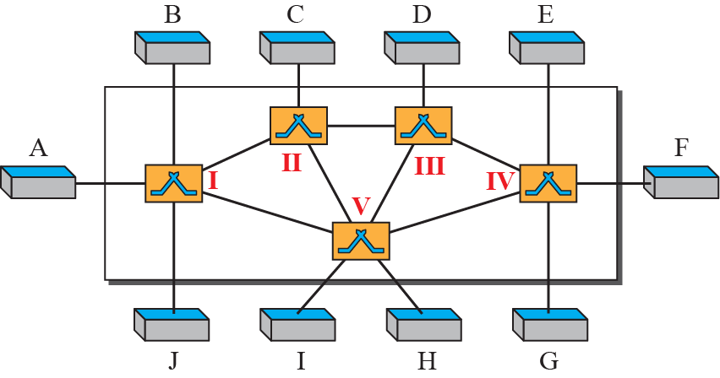
Figure 8.1: Switched network
8.4
Notes:
8.#

Slide 5
8.1.1 Three Methods of Switching
Traditionally, three methods of switching have been discussed: circuit switching, packet switching, and message switching. The first two are commonly used today. The third has been phased out in general communications but still has applications. Packet switching can further be divided into two subcategories, virtual-circuit approach and datagram approach, as shown in Figure 8.2.
8.5
Notes:
8.#

Slide 6
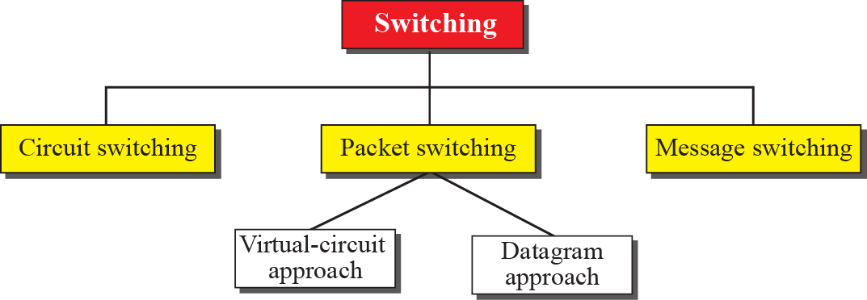
Figure 8.2: Taxonomy of switched networks
8.6
Notes:
8.#

Slide 7
8.1.2 Switching and TCP/IP Layers
Switching can happen at several layers of the TCP/IP protocol suite: at the physical layer, at the data-link layer, and at the network layer.
8.7
Notes:
8.#

Slide 8
    8-2 CIRCUIT-SWITCHED NETWORKS
A circuit-switched network consists of a set of switches connected by physical links. A connection between two stations is a dedicated path made of one or more links. However, each connection uses only one dedicated channel on each link. Each link is normally divided into n channels by using FDM or TDM, as discussed in Chapter 6.
8.8
Notes:
8.#

Slide 9
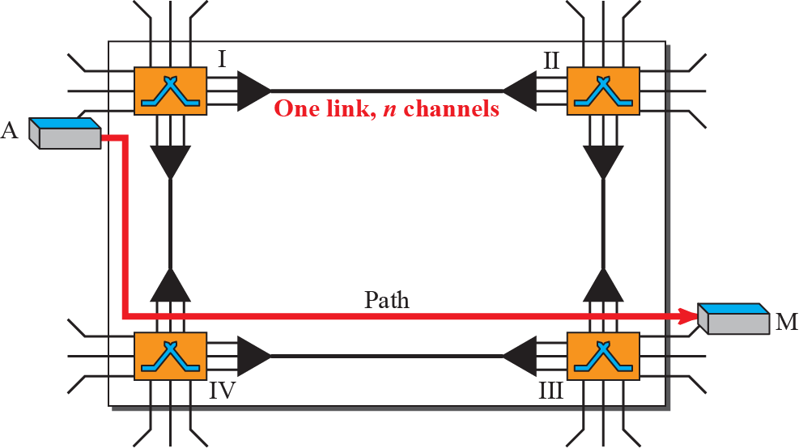
Figure 8.3: A circuit-switched network
8.9
Notes:
8.#

Slide 10
    CIRCUIT-SWITCHED NETWORKS
A needs to communicate with end system M, system A needs to request a connection to M that must be accepted by all switches as well as by M itself. This is called the setup phase
After the dedicated path made of connected circuits (channels) is established, the data-transfer phase can take place.
After all data have been transferred, the circuits are torn down.
8.10
Notes:
8.#

Slide 11
    CIRCUIT-SWITCHED NETWORKS
Circuit switching takes place at the physical layer.
Before starting communication, the stations must make a reservation for the resources to be used during the communication. These resources, such as channels (bandwidth in FDM and time slots in TDM), switch buffers, switch processing time, and switch input/output ports, must remain dedicated during the entire duration of data transfer until the teardown phase.
Data transferred between the two stations are not packetized (physical layer transfer of the signal). The data are a continuous flow sent by the source station and received by the destination station, although there may be periods of silence.
8.11
Notes:
8.#

Slide 12
Example 8.1
As a example, let us use a circuit-switched network to connect eight telephones in a small area. Communication is through 4-kHz voice channels. We assume that each link uses FDM to connect a maximum of two voice channels. The bandwidth of each link is then 8 kHz. Figure 8.4 shows the situation. Telephone 1 is connected to telephone 7; 2 to 5; 3 to 8; and 4 to 6. Of course the situation may change when new connections are made. The switch controls the connections.
8.12
Notes:
12

Slide 13
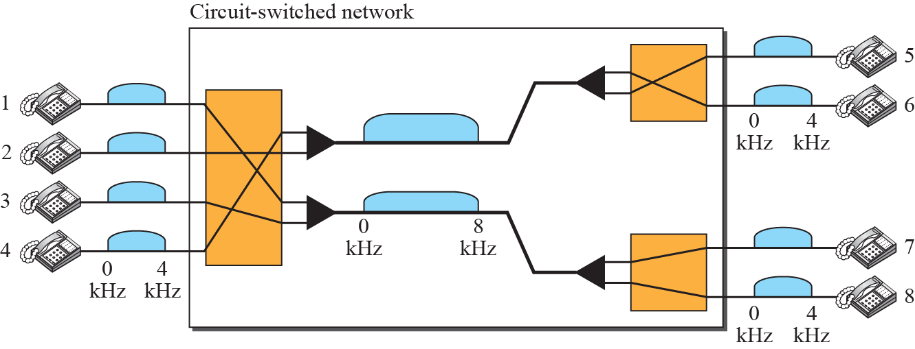
Figure 8.4: Circuit-switched network used in Example 8.1
8.13
Notes:
8.#

Slide 14
Example 8.2
As another example, consider a circuit-switched network that connects computers in two remote offices of a private company. The offices are connected using a T-1 line leased from a communication service provider. There are two 4 × 8 (4 inputs and 8 outputs) switches in this network. For each switch, four output ports are folded into the input ports to allow communication between computers in the same office. Four other output ports allow communication between the two offices. Figure 8.5 shows the situation.
8.14
Notes:
14

Slide 15
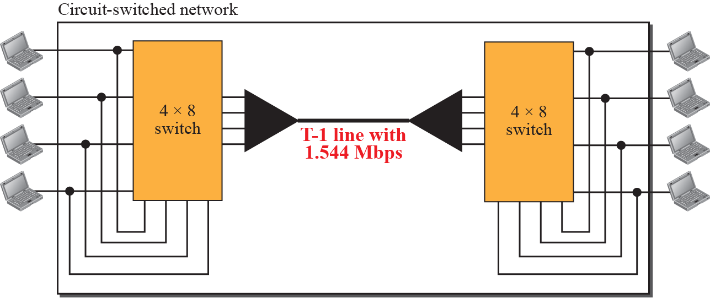
Figure 8.5: Circuit-switched network used in Example 8.2
8.15
Notes:
8.#

Slide 16
8.2.1 Three Phases
The actual communication in a circuit-switched network requires three phases:
connection setup,
data transfer, and
connection teardown.
8.16
Notes:
8.#

Slide 17
8.2.2 Efficiency
It can be argued that circuit-switched networks are not as efficient as the other two types of networks because resources are allocated during the entire duration of the connection.
These resources are unavailable to other connections.
In a telephone network, people normally terminate the communication when they have finished their conversation.
8.17
Notes:
8.#

Slide 18
8.2.3 Delay
Although a circuit-switched network normally has low efficiency, the delay in this type of network is minimal.
During data transfer the data are not delayed at each switch;
the resources are allocated for the duration of the connection.
Figure 8.6 shows the idea of delay in a circuit-switched network when only two switches are involved.
8.18
Notes:
8.#

Slide 19
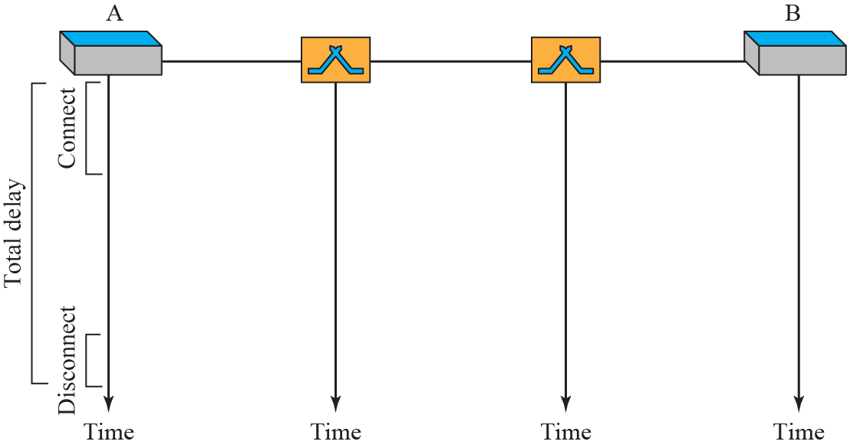
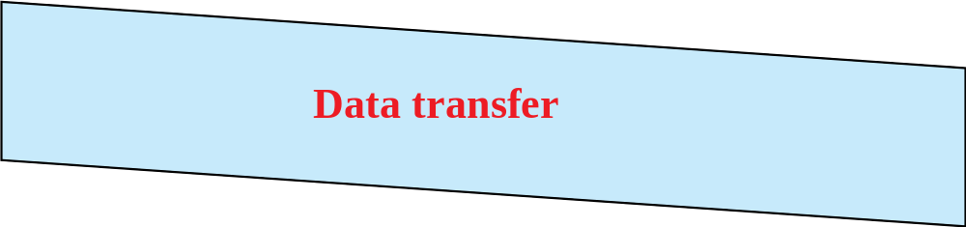
Figure 8.6: Delay in a circuit-switched network
8.19
Notes:
8.#

Slide 20
    8-3 PACKET SWITCHING
In data communications, we need to send messages from one end system to another.
If the message is going to pass through a packet-switched network, it needs to be divided into packets of fixed or variable size.
The size of the packet is determined by the network and the governing protocol.
8.20
Notes:
8.#

Slide 21
8.3.1 Datagram Networks
In a datagram network, each packet is treated independently of all others.
Even if the packet is part of a multi-packet transmission, the network treats it as though it existed alone.
Packets in this approach are referred to as datagrams.
8.21
Notes:
8.#

Slide 22
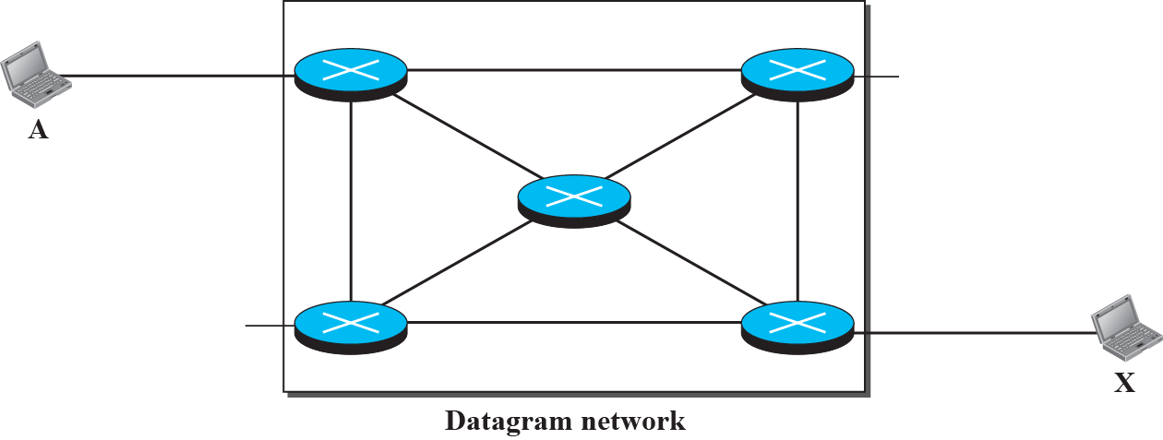






Figure 8.7: A Datagram network with five switches (routers)
8.22
Notes:
8.#

Slide 23
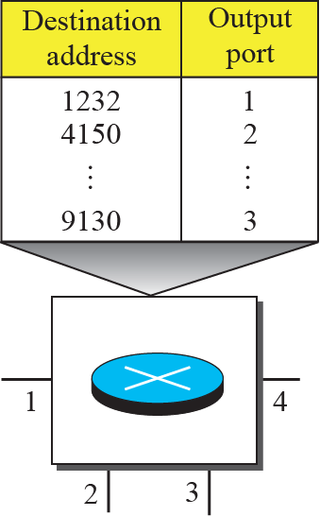
Figure 8.8: Routing table in a datagram network
8.23
Notes:
8.#

Slide 24
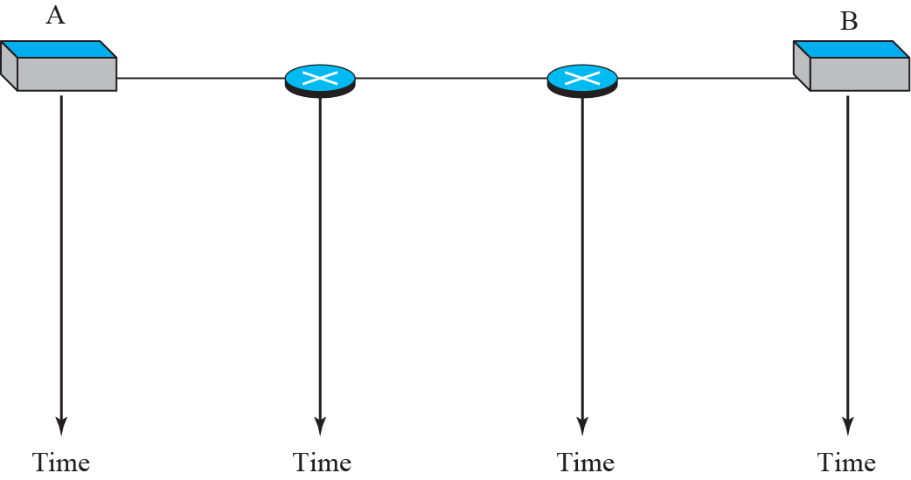

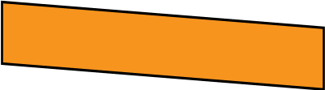


Figure 8.9: Delays in a datagram network
Total delay = 3T + 3P + w1 + w2
where T – transmission time, P - propagation time, w - waiting time
8.24
Notes:
8.#

Slide 25
8.3.2 Virtual-Circuit Networks
A virtual-circuit network is a cross between a circuit-switched network and a datagram network. It has some characteristics of both.
Setup and Teardown
Resource allocation
Packetization and address in the header
Path followed
8.25
Notes:
8.#

Slide 26
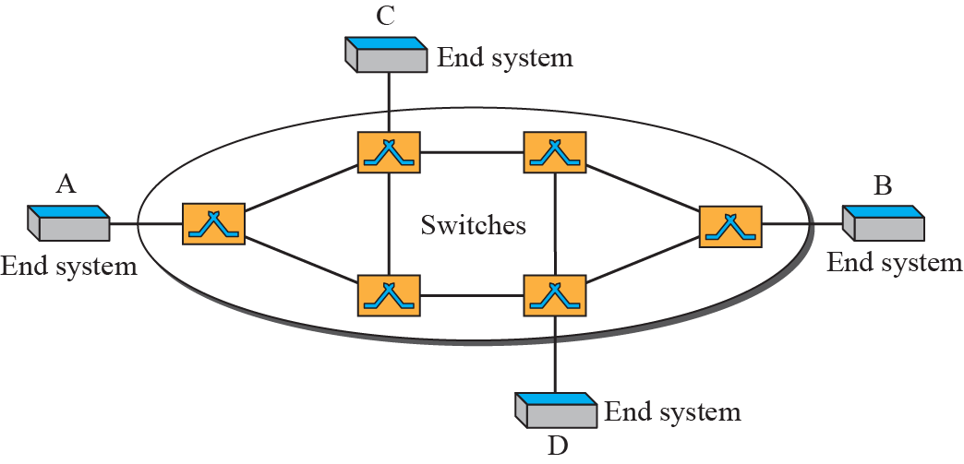
Figure 8.10: Virtual-circuit network
8.26
Notes:
8.#

Slide 27
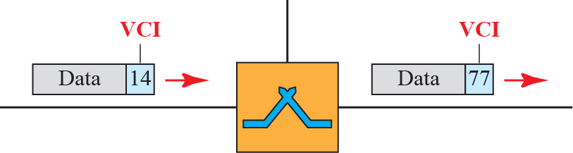
Figure 8.11: Virtual-circuit identifier
8.27
Notes:
8.#

Slide 28
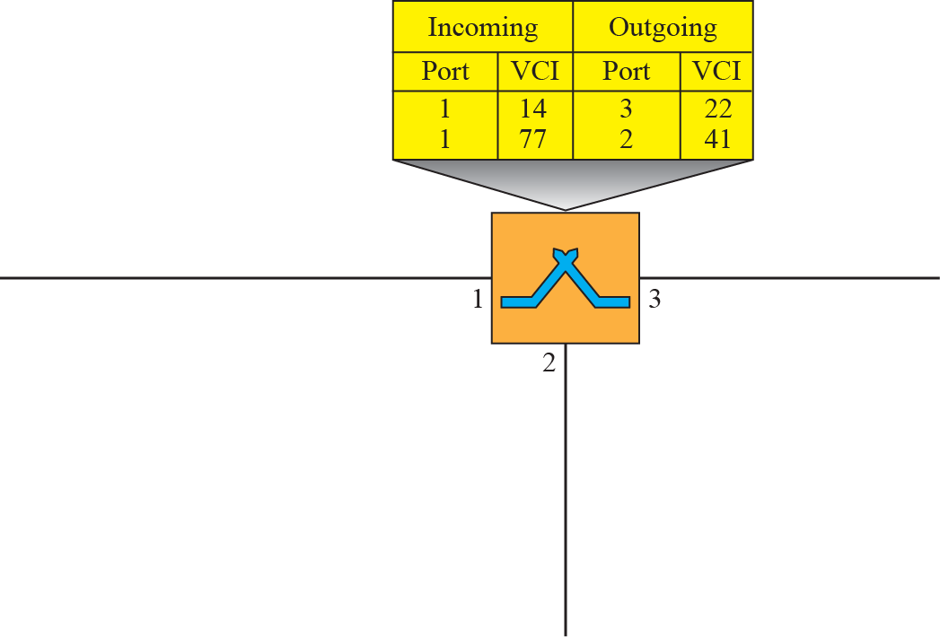



Figure 8.12: Switch and table for a virtual-circuit network
8.28
Notes:
8.#

Slide 29
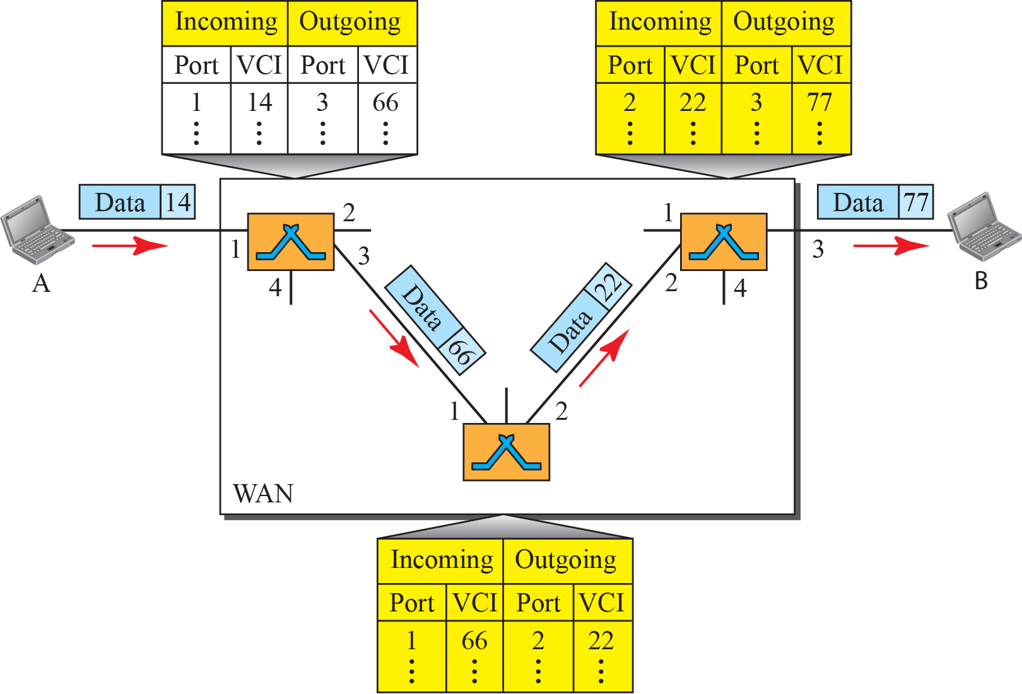
Figure 8.13: Source-to-destination data transfer in a virtual circuit network
8.29
Notes:
8.#

Slide 30
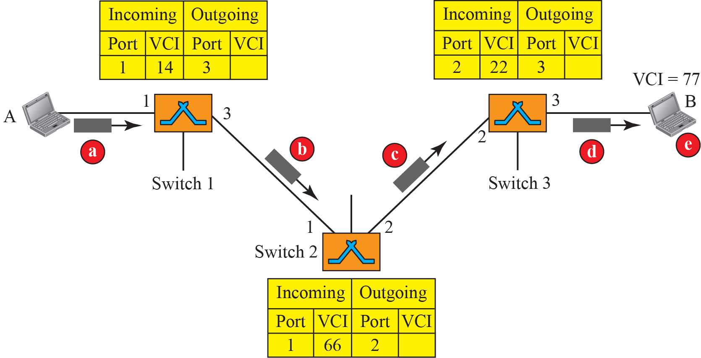
Figure 8.14: Setup request in a virtual-circuit network
8.30
Notes:
8.#

Slide 31
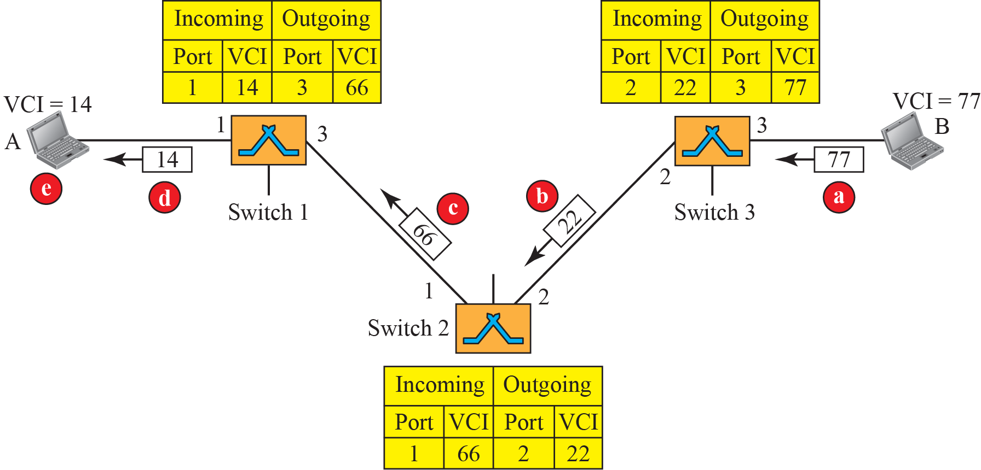
Figure 8.15: Setup acknowledgment in a virtual-circuit network
8.31
Notes:
8.#

Slide 32
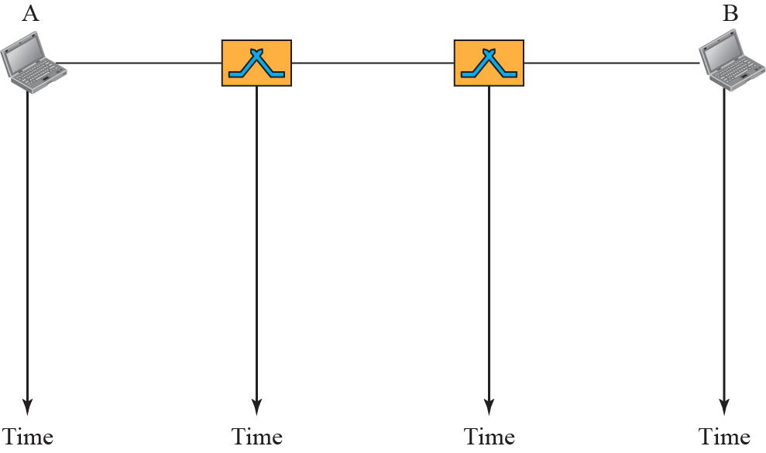


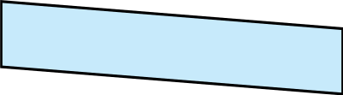

Figure 8.16: Delay in a virtual-circuit network
8.32
Notes:
8.#

Slide 33
Structure of a Switch
Structure of Circuit Switches
Primarily based on two technologies
  Space-Division Switch
  Time-Division Switch
8.33
Notes:
8.#

Slide 34
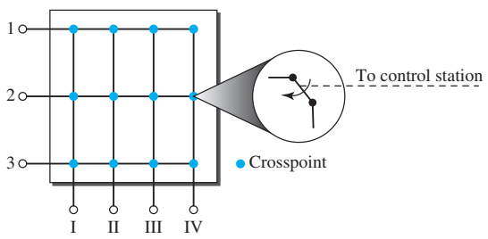
Space-Division Switch
The paths in the circuit are separated from one another spatially
Crossbar Switch
A crossbar switch connects n inputs to m outputs in a grid, using electronic microswitches (transistors) at each crosspoint
To connect n inputs to m outputs using a crossbar switch requires n × m crosspoints which is impractical.
A Crossbar Switch with 3 inputs and 4 outputs
8.34
Notes:
8.#

Slide 35
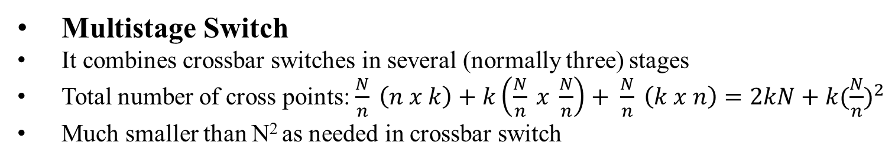
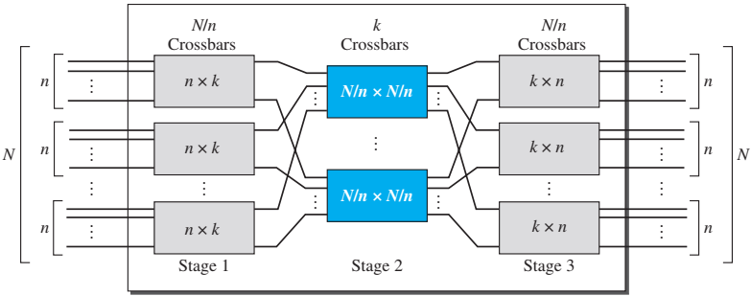
Space-Division Switch
A 3-stage multistage Switch
8.35
Notes:
8.#

Slide 36
Example 8.3
Design a three-stage, 200 × 200 switch (N = 200) with k = 4 and n = 20
Ans: The first stage will have N/n or 10 crossbars, each of size 20 × 4. The second stage, will have 4 crossbars, each of size 10 × 10. In the third stage, 10 crossbars, each of size 4 × 20.
The total number of crosspoints is 2kN + k(N/n)², or 2000 crosspoints. This is 5 percent of the number of crosspoints in a single-stage switch (200 × 200 = 40,000).
8.36
Notes:
36

Slide 37
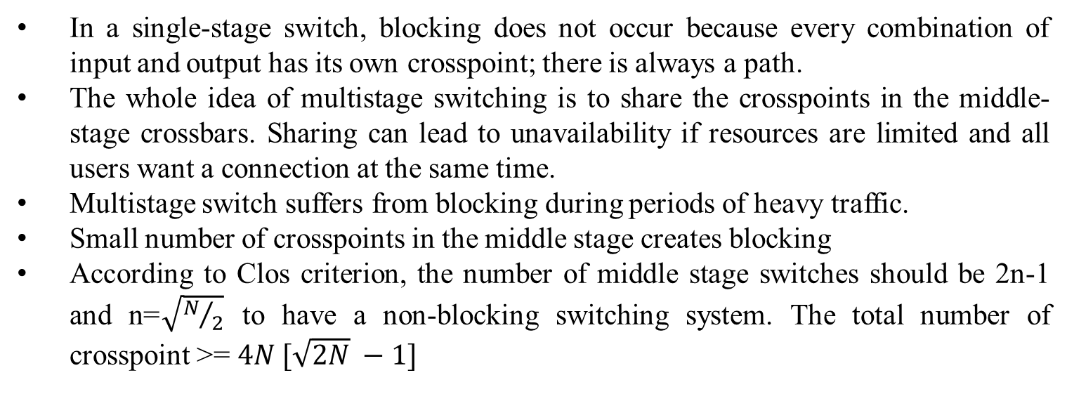
Blocking
8.37
Notes:
8.#

Slide 38
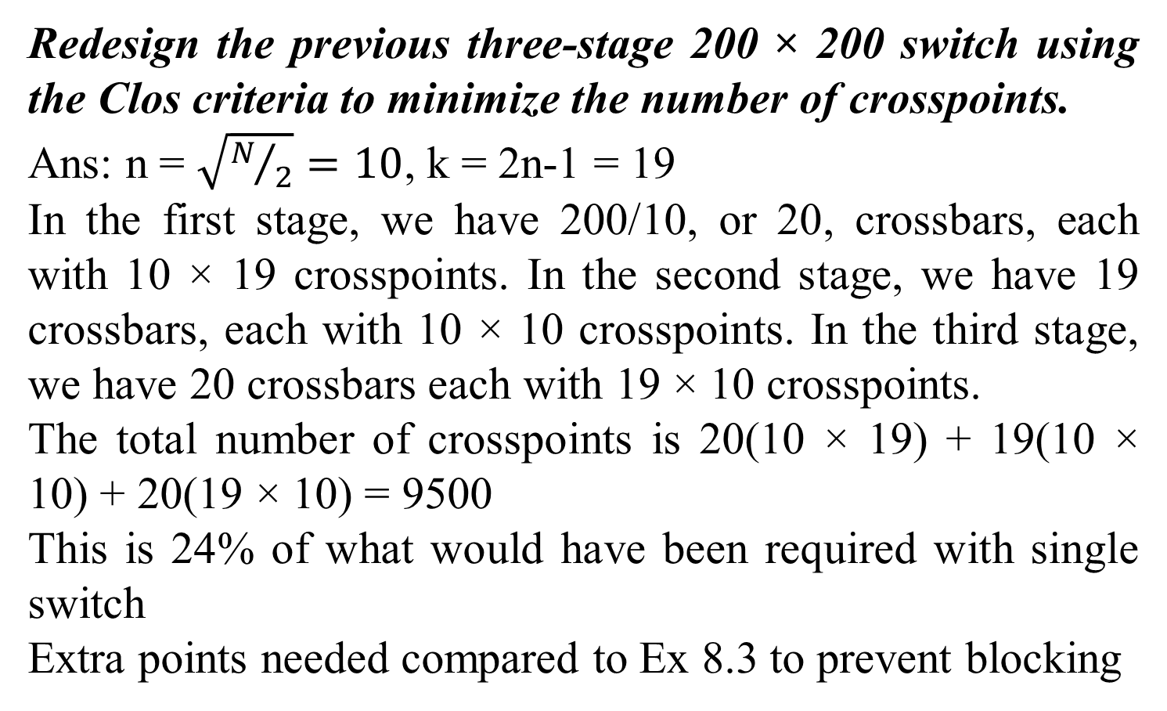
Example 8.4
8.38
Notes:
38

Slide 39
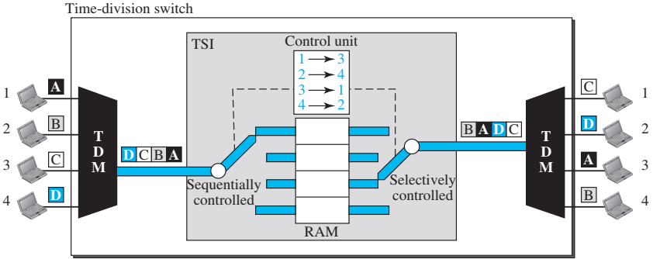
Time-Division Switch
Time-division switching uses TDM inside a switch. The most popular technology is called the time-slot interchange (TSI)
It has TDM MUX, DEMUX, and TSI
The slots are filled with incoming data from time slots in the order received. Slots are sent out in an order decided by the control unit.
8.39
Notes:
8.#

Slide 40
Space and Time-Division Switch Combinations
The advantage of space-division switching is that it is instantaneous. Its disadvantage is the number of crosspoints required to make space-division switching acceptable in terms of blocking.
The advantage of time-division switching is that it needs no crosspoints. Its disadvantage, in the case of TSI, is that processing each connection creates delays.
Combine space-division and time-division technologies to take advantage of the best of both.
Designed as time-space-time (TST) switches

Slide 41
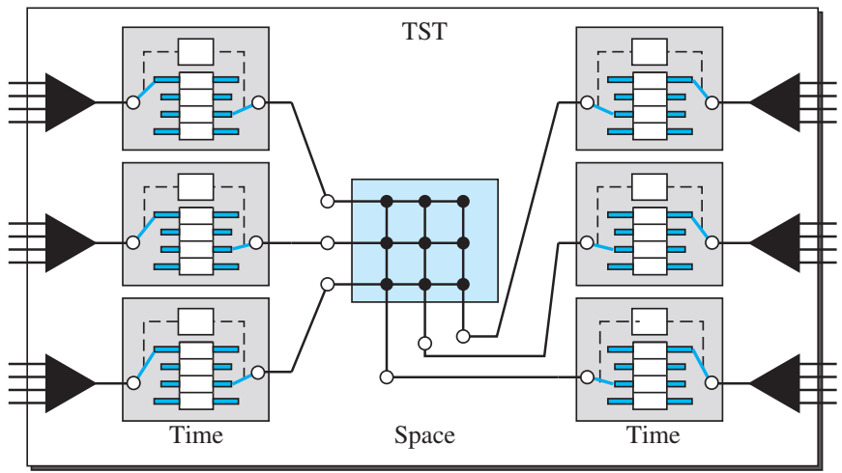
Space and Time-Division Switch Combinations
A simple TST switch with two time stages and one space stage and has 12 inputs and 12 outputs
8.41
Notes:
8.#

Slide 42
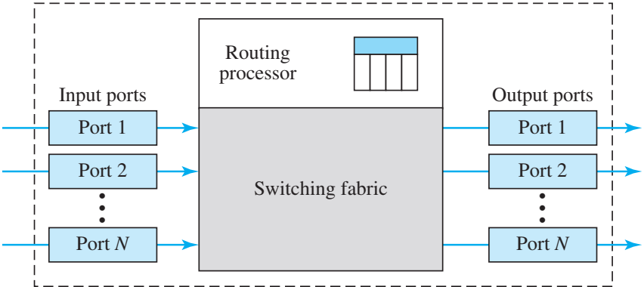
Structure of Packet Switches
A packet switch has four components: input ports, output ports, the routing processor, and the switching fabric

Slide 43
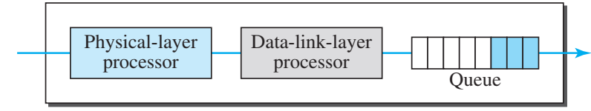
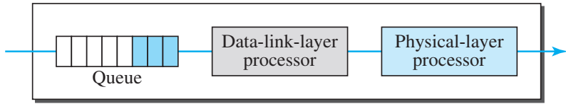
Structure of Packet Switches
Input port
Output port

Slide 44
Structure of Packet Switches
Routing Processor
  It uses destination address from the packet to determine address of the next hop and the output port
Switching Fabric
  Responsible for moving the packet from the input queue to the output queue
  The speed with which this is done affects the size of the input/output queue and the overall delay in packet delivery
  Some of the fabrics are:
    Crossbar switch
    Banyan switch
    Batcher-Banyan switch

Slide 45
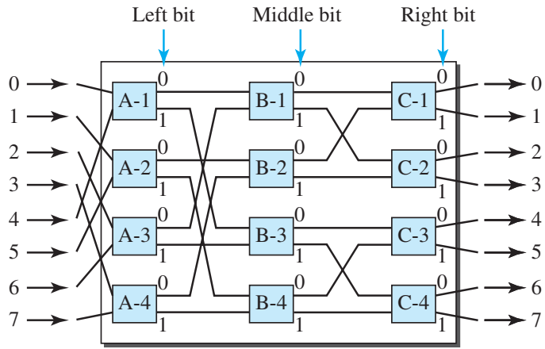
Banyan Switch
A banyan switch is a multistage switch with microswitches at each stage that route the packets based on the output port represented as a binary string.
For n inputs and n outputs, we have log₂ n stages with n/2 microswitches at each stage.
The first stage routes the packet based on the high-order bit of the binary string. The second stage routes the packet based on the second high-order bit, and so on.

Slide 46
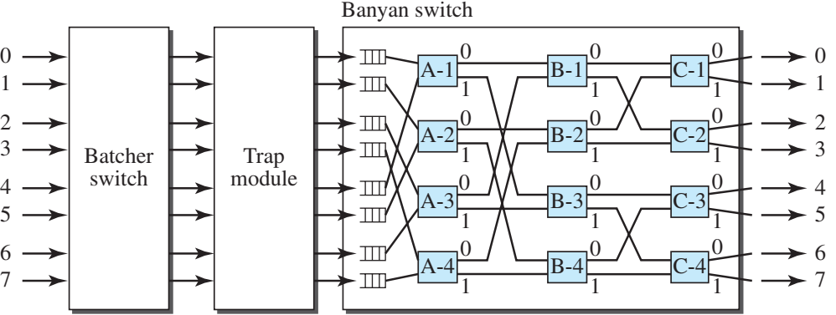
Batcher-Banyan Switch
Problem with the banyan switch is possibility of internal collision even when two packets are not heading for the same output port
K. E. Batcher designed a switch that comes before the banyan switch and sorts the incoming packets according to their final destinations.
Trap module prevents duplicate packets (the packets with the same output destination) from passing to the banyan switch simultaneously

